Slide 1

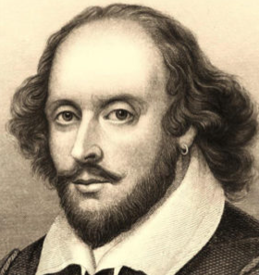
The Sentimental of Shakespeare BERT-Based Analysis Using Transfer Learning
Capstone Project Part B
23-2-R9
Students: Dorin Bachar & Moshe Moalem
Supervisors: Dr. Renata Avros Prof. Zeev Volkovich
Notes:
0:15 I am Dorin and this is Moshe I am excited to present our final project The project is “The Sentimental of Shakespeare BERT-Based Analysis Using Transfer Learning”

Slide 2
Table of contents
The Project's Objective
BERT vs ALBERT
Mathematical tools
Research Process
Shakespeare-BERT Pipeline
Impostors Models Training Process
7. Results
8. App Video
9. GUI
10. Diagrams
11. Testing Plan
12. Conclusions
Notes:
1:00 Dorin In the presentation, we'll display the project's objectives and the
models explored during our research (BERT and ALBERT), and differences between them.
We'll also explain the mathematical tools used in our model and provide an overview of the research process,
presenting the Shakespeare-BERT model.
we'll cover the BERT model's training process on impostor pairs,
showcasing results with examples from the training process and overall outcomes.
Additionally, we'll display the video , GUI, use case and activity diagrams, our testing plan,
and conclude with the project's conclusion.

Slide 3
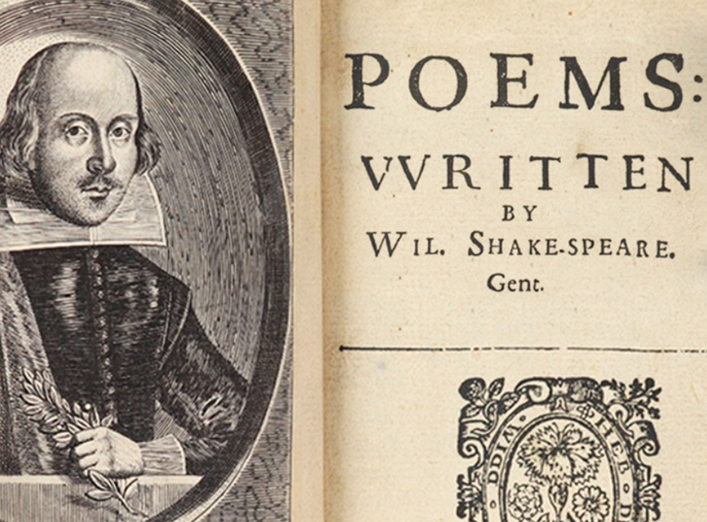
The Project's Objective
Our primary objective is to employ advanced machine learning techniques to distinguish authentic Shakespearean texts from those written by other known authors, referred to in our project as "impersonators"
Using the Shakespeare-BERT model, we fine-tune on distinct pairs of imposter writers, applying the model to predict and analyze texts attributed to Shakespeare. This approach allows us to evaluate the stylistic fingerprints specific to Shakespeare and to identify texts whose authorship might be misattributed.
By accurately predicting Shakespearean data using models trained on diverse pairs of authors, we demonstrate the robustness and consistency of our methodology, confirming the reliability of the outcomes across different author combinations.
This project highlights the potential of BERT combined with Dynamic Time Warping (DTW) and Isolation Forest algorithms for sentiment analysis and anomaly detection, with a primary focus on Shakespearean text.
Notes:
Dorin
Our primary objective is to employ advanced machine learning techniques to distinguish authentic
Shakespearean texts from those written by other known authors, referred to in our project as "impersonators"
To achieve this, we've employed the powerful Shakespeare-BERT model.
With this model, we've fine-tuned on distinct pairs of imposter writers, enabling us to predict and analyze texts attributed to Shakespeare.
This approach allows us to scrutinize the unique stylistic fingerprints specific to Shakespeare,
crucial for identifying texts whose authorship might be misattributed.
Moreover, by accurately predicting Shakespearean data using models trained on diverse pairs of authors,
we demonstrate the robustness and consistency of our methodology.
This ensures the reliability of our outcomes across different author combinations,
further enhancing the credibility of our findings.

Slide 4
BERT Model
BERT, standing for Bidirectional Encoder Representations from Transformers, utilizes the Transformer's architecture in a novel way.
It reads text in both directions, understanding the context from both sides of a word.
This bidirectional approach enhances the model's understanding of language semantics.
After pre-training, BERT proceeds to fine-tuning for specific tasks such as text classification or sentiment analysis.
This fine-tuning process enables BERT to specialize in a particular task.
BERT leverages the comprehensive linguistic knowledge acquired during pre-training to enhance its performance in the chosen task.
Notes:
Dorin

Slide 5
ALBERT Model
ALBERT, a Lite version of BERT, provides improved efficiency without compromising performance.
It achieves this through techniques such as parameter sharing, factorized embedding parameterization, and the addition of Sentence Order Prediction (SOP) in the pre-training process.
ALBERT is adept at various NLP tasks, including sentiment analysis, similarly to BERT.
Notes:
Dorin

Slide 6
BERT vs ALBERT
Feature / Model | BERT | ALBERT
Efficiency | Large number of parameters | Parameter sharing and factorization
Pre-training Objectives | Masked Language Modeling (MLM) and Next Sentence Prediction (NSP) | MLM,NSP, SOP(Sentence Order Prediction)
Training Time | Longer due to extensive pre-training | Shorter due to parameter reduction
After experimenting with models, we selected for a large BERT model for our project due to its superior performance compared to the tested ALBERT model.
Notes:
Dorin

Slide 7
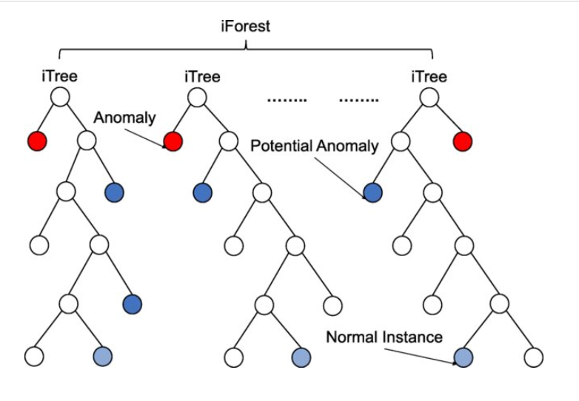
Isolation Forest
Isolation Forest: An anomaly detection algorithm developed by Fei Tony Lin in 2008.
Focuses on isolating anomalies instead of modeling normal instances within a dataset.
Divides the data into n trees to efficiently isolate anomalies, leveraging each tree's contribution in the process.
Utilizes random decision trees to segment data by randomly selecting features and split values.
Recursively splits the data until anomalies are isolated into their own leaf nodes.
Figure 1,isolation forest example [source]

Slide 8
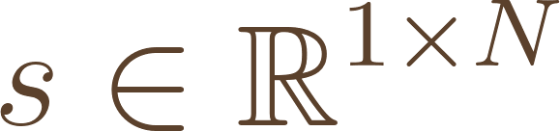
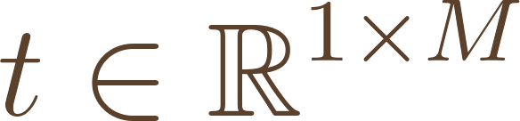
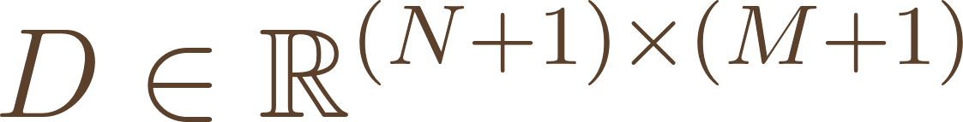
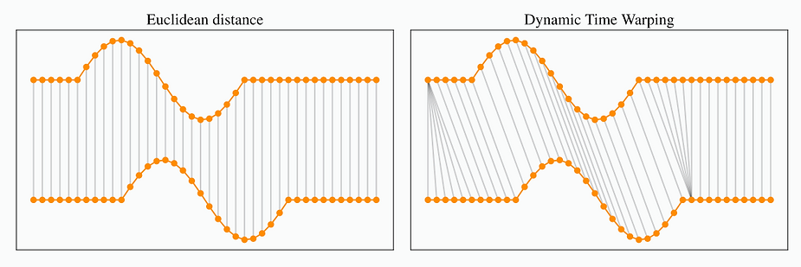
Dynamic Time Warping (DTW)
Algorithm that calculates similarity between two data sequences that may be in different lengths by stretching or compressing the time intervals of the sequences to minimize their overall distance.
Cost Matrix: Computes a matrix of costs that represents the distance between elements of two sequences.
Optimal Path: Finds the path through the cost matrix that minimizes the total distance, indicating the best alignment.
for sequences, and , cost matrix
For i 1-> n
For j 1->m
Figure 2, Euclidean distance VS DTW [source]
Notes:
Dynamic Time Warping, or DTW, is a method that measures the similarity between two sequences, which may vary in length. It achieves this by optimally aligning the sequences, stretching or compressing their time intervals to minimize the distance between them.
The process begins by constructing a cost matrix, where each cell quantifies the distance between elements of the two sequences. DTW explores all possible alignment paths within this matrix, then selects the "Optimal Path," which has the minimum total distance. This path highlights the most effective alignment between the sequences and actually it's the minimum distance between those two vectors.
This technique is integral to our analysis, allowing us to precisely calculate the distances between Shakespeare's texts.
Di-1,j, Di,j-1, and Di-1,j-1 representing the costs of an insertion, deletion, and match, respectively.

Slide 9
Research Process
Refinement project goals
BERT Training Challenges
Long training time
Transition to Efficient Methods
Fine-tuning instead of complete training
BERT Model
Shifted training model to BERT-L12 which achieved the best results
Models Choice
Switched different models for better results
Parameter Set-up
Adjusted chunk sizes, batch sizes, and tested additional layers like Dropout and Batch Normalization
Advanced Distance Computing
Employed Dynamic Time Warping instead of Euclidean distance
Anomaly Detection
Implemented the isolation forest algorithm
Results Analyzing
Notes:
Our research journey began by clarifying the project's needs and goals,as well as the methods of detecting the anomalies in shakespeare's texts
Initially, we trained full BERT model, which proved to be time-consuming. To optimize our process, we shifted to fine-tuning pre-trained models which indeed shorten a lot the training time and improved our efficiency.
Despite these improvements, we faced challenges in enhancing the model's performance. We experimented with different training parameters, adjusting chunk and batch sizes, and used techniques like Dropout and Batch Normalization to boost performance. However, we still encountered difficulties in achieving the desired results.
After several trials with different models, including various smaller BERT configurations and ALBERT models, we ultimately selected BERT-L12 for its consistent and reliable performance.
With the model effectively trained, our next step was to analyze the textual data. Initially, we used Euclidean distance for this task, but soon switched to Dynamic Time Warping, which offered a better results.
To detect anomalies, we implemented the isolation forest algorithm, which was crucial in identifying texts that diverged significantly from the Shakespearean style we were examining.
The final phases of our project involved analyzing the results, developing a user-friendly graphical user interface, and write our finding into project book.

Slide 10
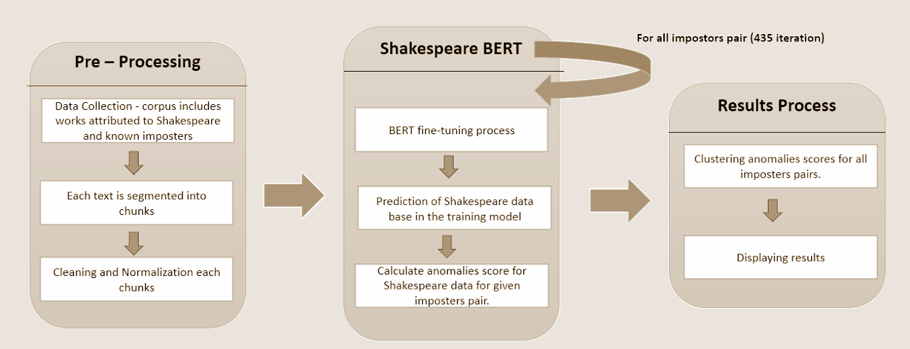
Shakespeare-BERT Pipeline
Figure 3, Model Flow-Chart.
Notes:
In our analysis of Shakespearean authorship, we structured our approach into three key stages:
First Stage: Preprocessing — We began by loading the corpus of texts from Shakespeare and known imposters. Each text was segmented into 400-word chunks, which we found optimal for training. We then cleaned and normalized the texts by removing special characters and converting all text to lowercase, ensuring consistency across the dataset.
Repeated Models Fine-Tuning with Shakespeare-BERT — For each unique pair of imposters, we fine-tuned a separate instance of the BERT model. This crucial step tailored the model to recognize and replicate the linguistic styles of the imposters, setting the stage for a direct comparison with Shakespeare's writing. We divided the data into training, testing, and validation sets to refine the learning process and precisely evaluate the model's performance.
Shakespeare Prediction — After fine-tuning, we applied the model to Shakespeare's texts, This critical phase allowed the model to leverage its training on the imposters' styles to generate predictions that mirror the stylistic nuances of Shakespeare's writing.
Advanced Distance Computing and Anomaly Detection — We utilized Dynamic Time Warping to measure the stylistic distances between Shakespeare’s text chunks, helping us gauge their similarity or disparity. Following this, we employed the isolation forest algorithm to pinpoint anomalies, or text chunks that were different from the expected Shakespearean style. This step highlights the model's capability to identify texts that may not conform to typical Shakespearean attributes.
Results Analysis — In the final stage, we processed our findings by normalizing and clustering the anomaly scores. This helped us pinpoint texts definitively authored by Shakespeare and those with questionable authorship. We concluded by visualizing these classifications, providing clear and immediate insights into our results.
Through these stages, we've developed a nuanced understanding of Shakespearean authorship, enhancing our ability to identify authentic writings from those of his contemporaries.

Slide 11
Imposters Models Training Process
Framework and Tools:
Utilized TensorFlow architecture and pipeline functions for robust model training.
Employed Google Colab Pro with GPU acceleration to enhance training efficiency.
Training Dynamics:
435 Different Models: Corresponding to the number of imposters pairs.
Training Parameters: Each imposters pair model trained over 5 epochs average training of two hours.
Monitoring and Outputs:
Model Logs: Include iteration number (imposters pair model), imposters' names, loss, and accuracy to monitor learning performance.
Anomaly Detection: Identification of Shakespeare texts that deviate from norms, using anomaly scores and summed distances.
Data Storage: Anomaly and distances scores along with model predictions and distance scores saved in files for analysis purposes.
Efficiency Enhancements:
Checkpoint Resumption: Script modifications allow training to resume from the last saved state, significantly reducing redundant training time.
Notes:
In our project, we leveraged TensorFlow for its powerful architecture and pipeline capabilities, enhancing our training efficiency with GPU acceleration from Google Colab Pro.
We created 435 distinct models, each tailored to a unique pair of imposter authors. Each model was trained over five epochs, with sessions averaging two hours, allowing us to fine-tune the nuances of imposters' writing styles.
Our training logs are includes the iteration number and involved imposters, and also include information of the training itself like loss and accuracy to ensure effective learning.
For anomaly detection, we analyzed Shakespeare texts for deviations from norms, using anomaly scores and summed distances, and stored all key data for in-depth analysis later.
To increase efficiency, we integrated checkpoint resumption in our scripts, minimizing redundant work and maximizing resource use.

Slide 12
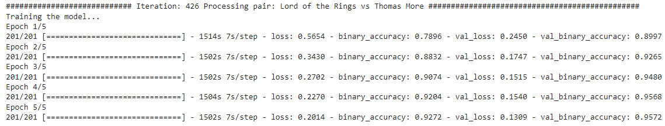
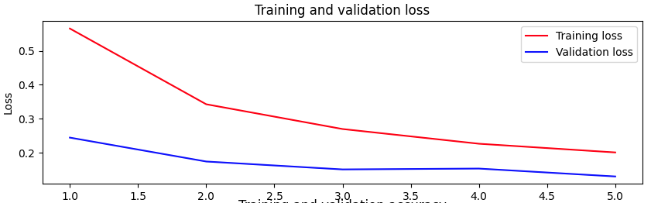
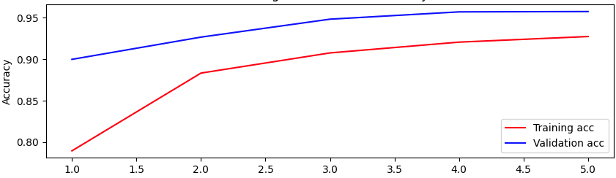

Single Model Training Results (Example)
Figure 3, training results for each epoch
Figure 4, loss function
Figure 5, accuracy function
Figure 6, results of final epoch

Slide 13
Single Model Outliers Log (Example)
Outlier Detection Results:
text to classify.txt 0
Arden of Feversham.txt 1
King Henry IV, Part 1.txt 2
KING EDWARD III by Shakespeare.txt 3
A LOVERS COMPLAINT.txt 4
A Yorkshire Tragedy by Shakespeare.txt 5
AS YOU LIKE IT.txt 6
A MIDSUMMER NIGHT_S DREAM.txt 7
CYMBELINE.txt 8
KING HENRY V.txt 9
KING HENRY VI Part II.txt 10
Fair Em by Shakespeare.txt 11
KING HENRY VI part I.txt 12
KING RICHARD II.txt 13
KING HENRY VIII.txt 14
KING HENRY VI Part III.txt 15
KING JOHN.txt 16
KING RICHARD III.txt 17
Love_s Labour_s Lost.txt 18
Merchant of Venice.txt 19
MEASURE FOR MEASURE.txt 20
MUCH ADO ABOUT NOTHING.txt 21
Locrine Mucedorus by Shakespeare.txt 22
…
Potential outliers based on distance sum:
text to classify.txt 0
Fair Em by Shakespeare.txt 10
The Life and Death of the Lord Cromwell by Shakespeare.txt 31
The Merry Devill of Edmonton by Shakespeare.txt 33
THE TRAGEDY OF KING LEAR.txt 42

Slide 14
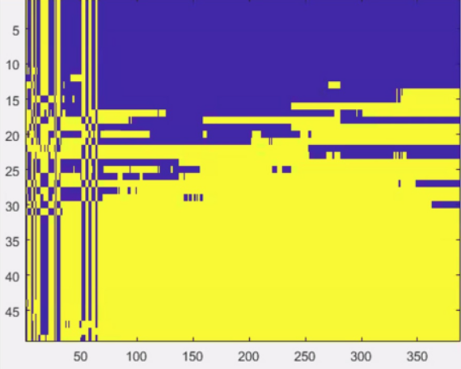
Clustered Data Results
Shakespeare's texts
Iterations
Figure 7,Shakespeare's texts clustering along different models.
Notes:
צהוב מצביע על טקסטים חשודים של שייקספיר
כחול מצביע אנומליה - טקסטים חשודים לא שייקספיר
ניתן לראות שבאיטרציות הראשונות באמת התוצאות לא היו ברורות ואחידות וככל שמתקדמים עם האיטרציות התוצאות מתכנסות בהתאם לציפיות.

Slide 15
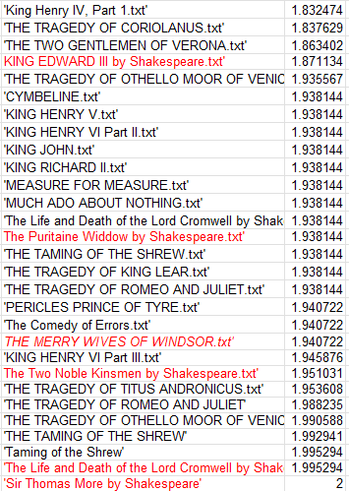
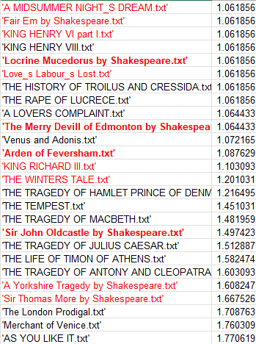
Over all models Results
Figure 8, Over all models Results.
Notes:
Final normalized scores for the texts, scores under 1.5 are suspect as anomalies, meaning not shakespearean texts.
The highlighted texts in red are known texts that are now known that wasn’t written by shakespeare, and bolded texts in red are texts which their writer is quiestanble.
you can see that the model had some really good results, as well some downfalls too.
Fairem by shakespeare, even though in the name it said written by shakespeare, it wasn't’ and the scores is indeed close to 1.
The famous play romeo and juliet received score closes to two..

Slide 16
Results (Examples)
Clear Identification of Shakespearean Texts: "The Tragedy Romeo and Juliet" (Score: 1.9882)
One of Shakespeare's famous plays that indeed received a high score.
Misclassification Issues: “A Midsummer Night's Dream” (score 1.06)
May reflect the model's difficulty in capturing the unique comedic style and linguistic subtleties of Shakespearean comedies.
Correct Identification of Non-Shakespearean Texts: “Fair Em by Shakespeare” (Score: 1.06)
Historically, this play has uncertain authorship and is often not included in the Shakespearean canon. The model’s low score supports the argument that it may not have been written by Shakespeare.
Notes:
Enhancing the training dataset with more examples from Shakespeare’s comedic works could help improve the model’s ability to recognize and accurately classify these lighter, more whimsical texts.

Slide 17

App Video

Slide 18
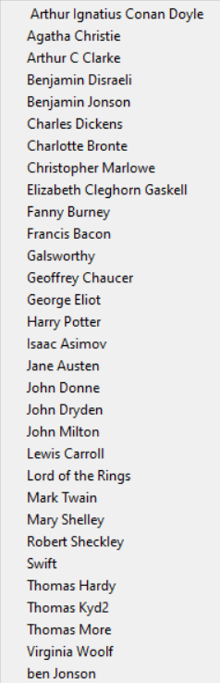
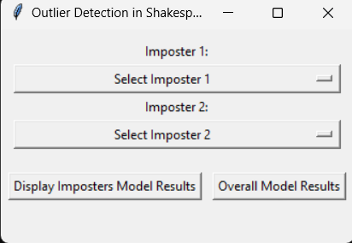
GUI
Figure 9,system's main page.
Figure 10,imposters list.
Notes:
Dorin

Slide 19
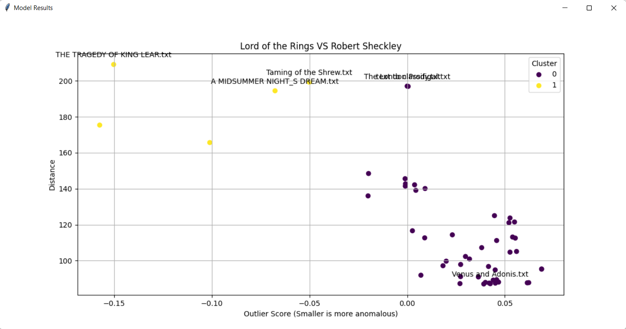
Displaying Imposters Pair Model Result(Example)
Figure 11,example, results for imposters model
Notes:
Dorin
Example: Lord of rings and Robert Sheckley. After pressing a button, the model's results are displayed

Slide 20
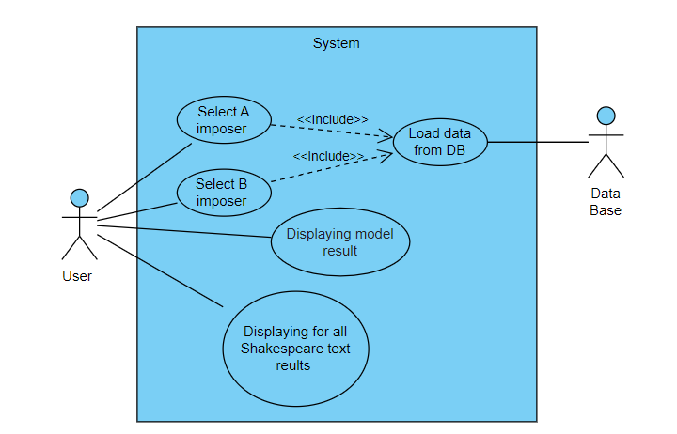
Diagrams
Use Case
Figure 12, use case diagram
Notes:
Dorin

Slide 21
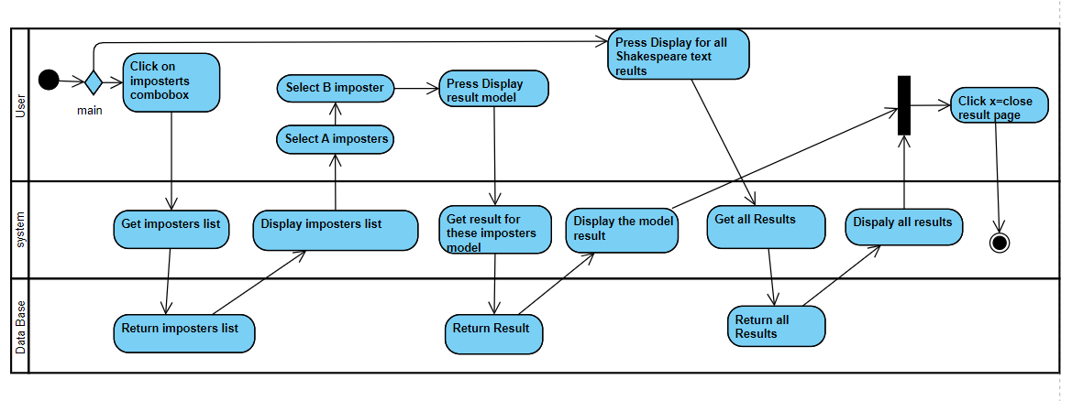
Diagrams
Activity Diagram
Figure 13, Activity Diagram
Notes:
Dorin

Slide 22
Testing Plan
Test Number | Test Subject | Expected Result | Pass/Fail
1 | Open the GUI. | The GUI loads successfully. | Pass
2 | Select the first imposter name from the combo box. | The name of the first imposter appears in the first combobox. | Pass
3 | Select the second imposter name from the combo box. | The name of the second imposter appears in the first combobox. | Pass
4 | Select two imposters and click the Display model result button. | Open the modal result window. | Pass

Slide 23
Testing Plan
5 | Click the display model result button without filling in all the fields. | Error message – Pair not found within the valid range. | Pass
6 | Select imposter A and not imposer B and click the Display model result button. | Error message – Pair not found within the valid range. | Pass
7 | Select imposter B and not imposer A | It is not possible to select impersonator B before impersonator A | Pass
8 | Click the all for the Shakespeare texts results. | open the graph results window. | Pass

Slide 24
Conclusions
Employed the Shakespeare-BERT model to effectively distinguish between authentic Shakespearean texts and imposters
Historical Language Variation: Recognize that some inaccuracies in model performance may stem from the substantial linguistic changes over the 400 years since Shakespeare's texts were written.
Continuous Calibration: Highlight the necessity for ongoing calibration of the model to refine its accuracy and adapt to the nuances of Early Modern English.
Emphasizes the importance of ongoing advancements in AI for expanding the horizons of literary studies.
Notes:
In conclusion, our project successfully harnessed the Shakespeare-BERT model to discern authentic Shakespearean texts from those of imposters. This process not only enhanced our understanding of Shakespeare's work but also pushed the boundaries of how we apply machine learning in literary studies.
Historical Language Variation:
We acknowledge that some of the inaccuracies in our model's performance could be due to the vast linguistic evolution over the past 400 years. Shakespeare's texts are steeped in Early Modern English, which presents unique challenges due to its differences from contemporary language.
Continuous Calibration:
To improve accuracy, we emphasize the need for continuous calibration of our model. This ongoing adjustment will allow the model to better capture and interpret the subtleties of historical texts, ensuring more reliable identification of Shakespearean language.
Advancements in AI:
The project underscores the critical role of advancements in artificial intelligence in expanding our ability to analyze and understand literature. As AI technology progresses, so too will our capabilities to delve deeper into the complexities of literary authorship and historical texts.

Slide 25
Thanks
Dorin and Moshe

Slide 26
References
[1] https://www.researchgate.net/publication/352017898_Point-Denoise_Unsupervised_outlier_detection_for_3D_point_clouds_enhancement/figures?lo=1&utm_source=google&utm_medium=organic
[2 ]https://rtavenar.github.io/blog/dtw.html
https://www.youtube.com/watch?app=desktop&v=vsGN8WqwvKg
https://cherkov.com/art-and-not-only/william-shakespeare/

Slide 27
Back-up

Slide 28
BERT Training Process
Two-Stage Training Approach:
Pre-training Tasks:
Trained on unlabeled data for learning language representation while using 2 methods:
Masked Language Modeling (MLM) to understand correlation between words in the same sentence.
Next Sentence Prediction (NSP) to understand correlation between different sentences.
Fine-tuning Process:
After pre-training, BERT is fine-tuned for specific downstream tasks, such as text classification or sentiment analysis.
Fine-tuning allows BERT to specialize in a particular task while still leveraging the rich linguistic knowledge acquired during pre-training.

